Slide 1
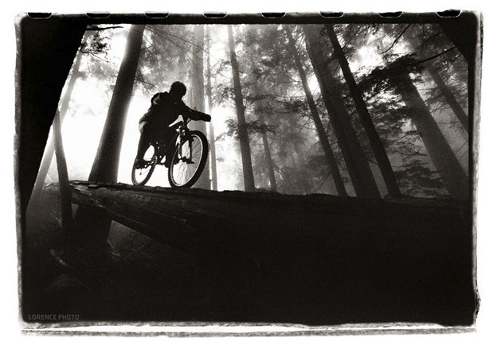
Mountain Bike (MTB) Analysis
Mike Czerwinski & Justin Schulberg

Slide 2









Slide 3




Project Overview

Slide 4
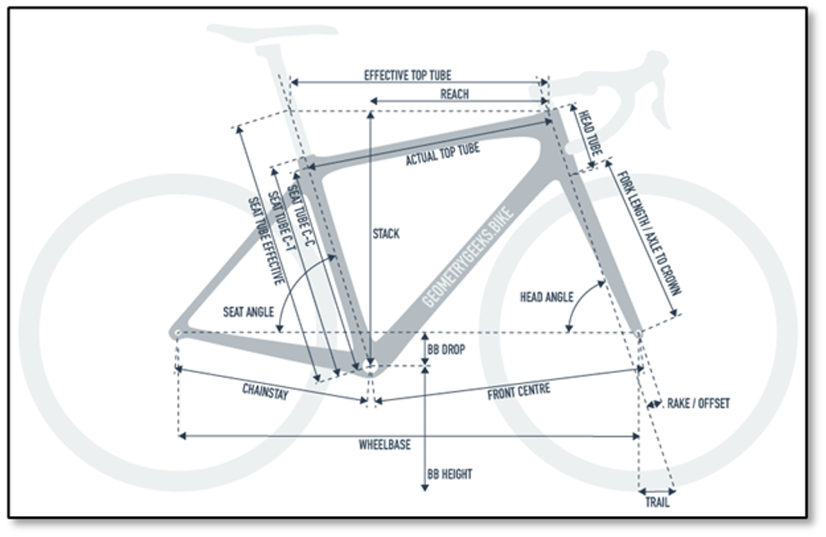
The goal of our project is to determine how many, if any, discrete categories should exist for mountain bikes. Since most specifications and geometric measurements have one direction when moving across the spectrum of bikes, it’s reasonable to believe that these measurements could be reduced to much fewer dimensions, and perhaps even one continuous principal component rather than discrete categories.
Different types of geometric specifications on mountain bikes.

Slide 5
Mountain Bike Categories
Currently, full suspension mountain bikes come in multiple categories:
Cross Country (XC)
Downcou-ntry
Enduro
MTB Categories
All Mountain
Trail

Slide 6
Mountain Bike Categories: XC
Currently, full suspension mountain bikes come in multiple categories:
Cross Country (XC)
Downcou-ntry
Full-suspension cross-country bikes feature steeper geometry than other types of mountain bikes and are designed for pure speed and efficiency. They generally have no more than 120mm of suspension travel, and the suspension design is optimized for efficiency.
Enduro
MTB Categories
All Mountain
Trail

Slide 7
Mountain Bike Categories: Enduro
Currently, full suspension mountain bikes come in multiple categories:
Cross Country (XC)
Enduro bikes are designed to be able to climb up to the top of the mountain but really shine on the way back down. For this reason, they feature more than 150mm of suspension travel and an even slacker frame. The components will all be beefed up to handle the rigors of challenging, rough terrain. If a trail bike is a jack of all trades, then enduro bikes are biased toward downhill performance.
Downcou-ntry
Enduro
MTB Categories
All Mountain
Trail

Slide 8
Mountain Bike Categories: Trail
Currently, full suspension mountain bikes come in multiple categories:
Cross Country (XC)
Downcou-ntry
Trail riding and the corresponding trail bikes refer to what can be thought of as ‘everyday’ mountain bike riding. Trail bikes are designed to have as much fun as possible on any given terrain and be just as capable on the climbs as they are on the descents. Trail bikes have traditionally been thought of as jack of all trades bikes.
Enduro
MTB Categories
All Mountain
Trail

Slide 9
Mountain Bike Categories: All Mountain
Currently, full suspension mountain bikes come in multiple categories:
Cross Country (XC)
Downcou-ntry
A more niche category which some manufacturers claim to be more downhill focused than trail bikes, but not designed for downhill races like Enduro bikes are.
Enduro
MTB Categories
All Mountain
Trail

Slide 10
Mountain Bike Categories: Downcountry
Currently, full suspension mountain bikes come in multiple categories:
Cross Country (XC)
Downcou-ntry
Full-suspension cross-country bikes feature steeper geometry than other types of mountain bikes and are designed for pure speed and efficiency. They generally have no more than 120mm of suspension travel, and the suspension design is optimized for efficiency.
Enduro
MTB Categories
All Mountain
Trail

Slide 11





Exploratory Data Analysis

Slide 12
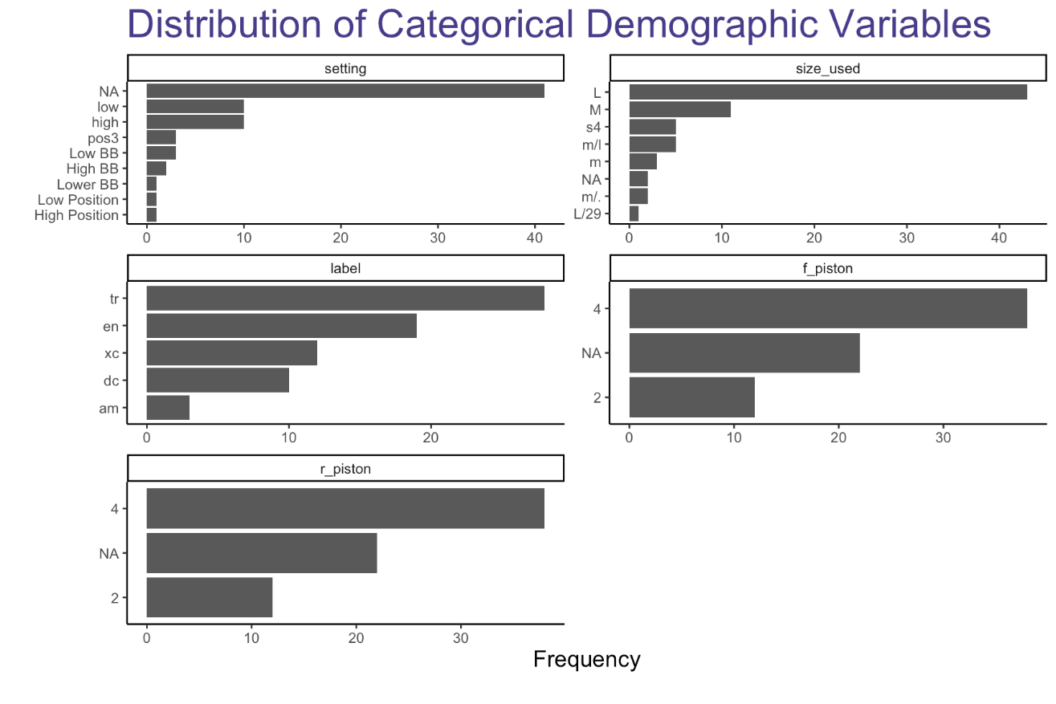
EDA: Categorical Variables
To the right, we see that most of the bikes don’t have a setting, which is used to help differentiate between different versions of the same bike.
Most of the bikes being analyzed are trail bikes, with the smallest grouping of bikes being all mountain bikes.
Most of the bikes analyzed have 4 rear/front pistons. The two variables seem to be perfectly in-sync, leading us to believe that they’re highly correlated.

Slide 13
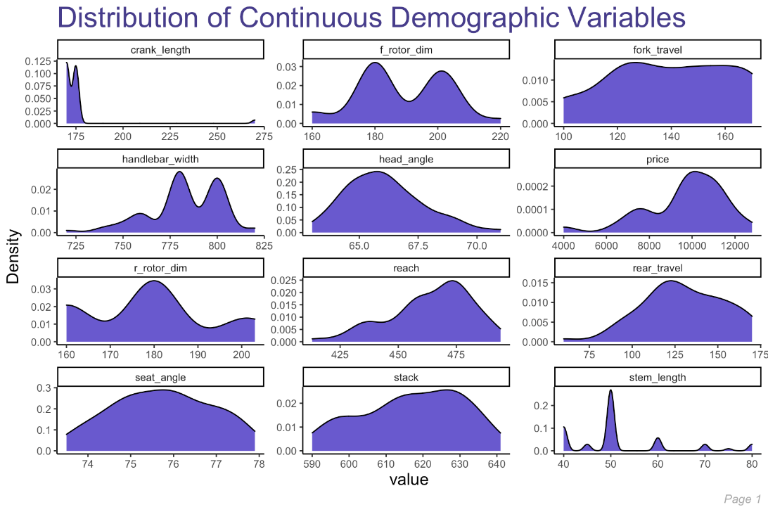

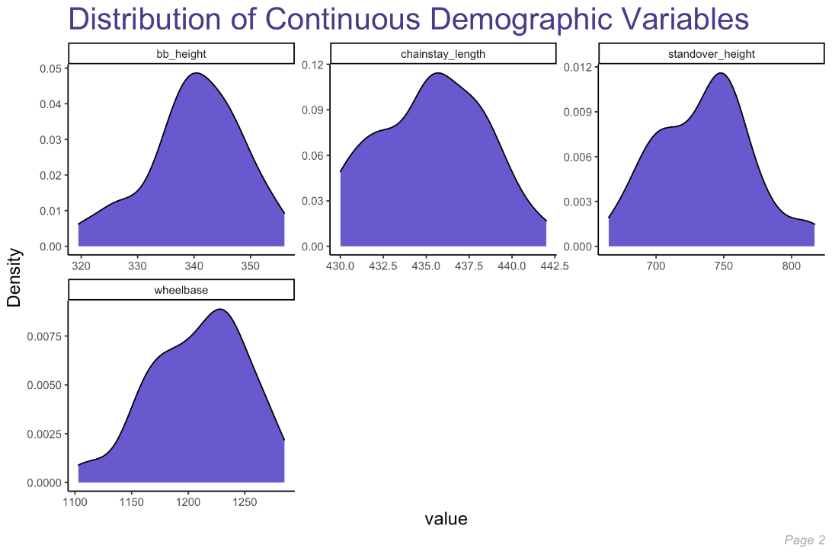


EDA: Continuous Variables
To analyze the continuous features within our dataset, we built density plots for each of them to better understand their distribution.
~Normally Distributed Variables:
Chainstay_length
Fork_travel
Bb_height
Seat_angle
Skewed Variables:
Head_angle (skewed right)
Handlebar_width (skewed left)
Wheelbase (skewed left)
Multi-Modal Distributed Variables:
f_rotor_dim / r_rotor_dim
Stem_length

Slide 14


Variation Amongst Featureset
The first thing we’ll do is look to see if any of the features in our dataset are better at explaining the variation amongst the different bikes than other features. That is, it’s completely possible that two features are similar and don’t have much variation in them, even across some of the different bike categories. To do so, we’ll:
Look for highly correlated features and flag these for potential removal;
Run Principal Component Analysis (PCA) to see if certain features are better at explaining the variation in our data better than others.

Slide 15
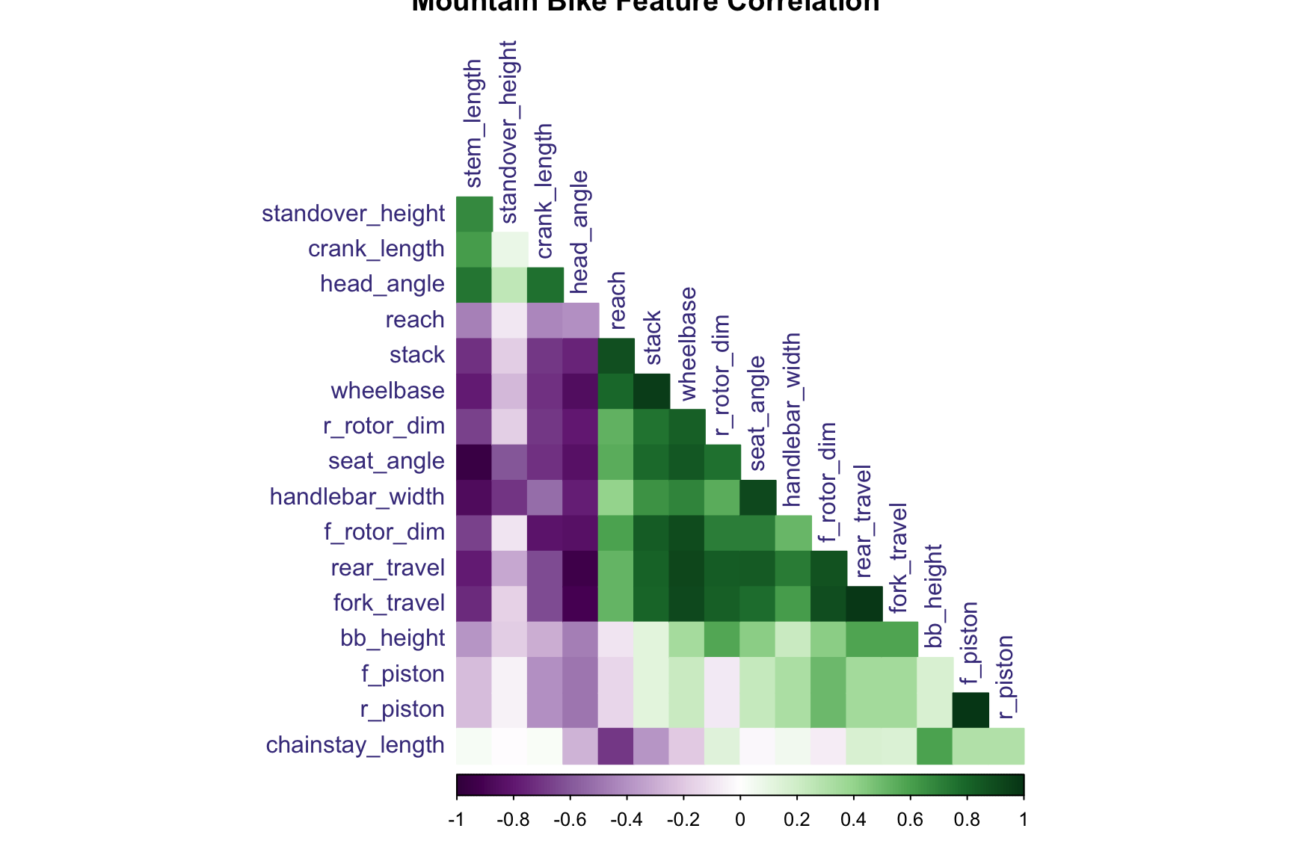
Correlation Amongst Features
Here we see some obvious correlations, for example:
f_piston (front brakes) is perfectly correlated with r_piston (rear brakes), which makes sense since mountain bikes tend to use the same types/spec of brakes for the front vs. rear tires.
fork_travel has a correlation above .95 with: c(“rear_travel”, “fork_travel”). This make sense; for example, rear_travel should be highly correlated with fork_travel.

Slide 16
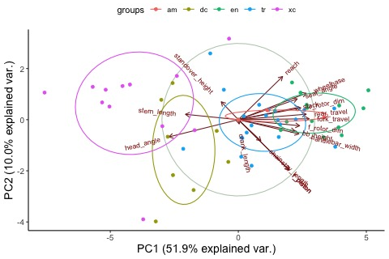
Principal Component Analysis (PCA)
Next, we’ll apply PCA to our dataset. In so doing, we’ll have to center and scale our data given how different the ranges are for certain measurements. To visualize our data, we reduce to 2 Principle components. Let’s take a look at our 4 principal components which explain the largest proportion of variance in the data:
Variable | PC1 | PC2 | PC3 | PC4
Standard Deviation | 3.126 | 1.665 | 1.329 | 1.252
Proportion of Variance | 0.5748 | 0.1631 | 0.1039 | 0.09223
Cumulative Proportion | 0.5748 | 0.7379 | 0.8418 | 0.934
Top 2 Principal Components, shaded by MTB category label.

Slide 17



Clustering Analysis

Slide 18
Unsupervised Learning
Because we are investigating the validity of mountain bike categories, one approach is to treat this dataset as unsupervised, stripping the bikes of their labels.
Hypothesis:
Applying our own clustering algorithms will either give us a different set of clusters (rather than the 5 pre-ordained categories) OR will not provide clearly defined clusters, leading us to believe that the bikes are actually created on a spectrum and cannot be grouped into one of the 5 pre-ordained categories.

Slide 19
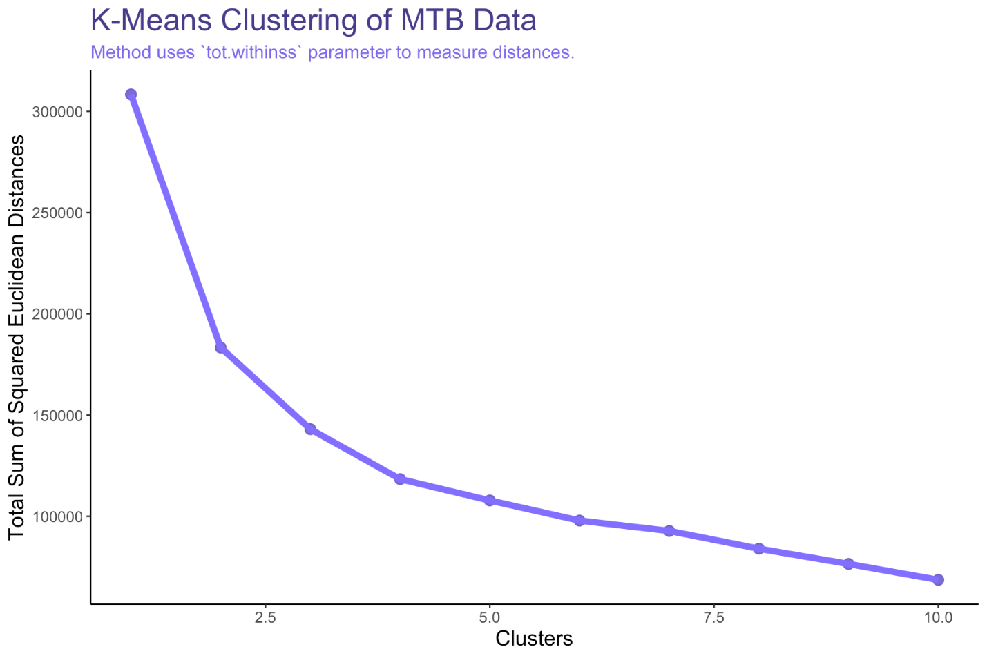
K-means Clustering
Standard scaled data so that each variable is mean centered with standard deviation = 1.
Measuring goodness of fit using Total Sum of Euclidean Distances from each point to assigned cluster center
Expected decrease in total distance with more cluster centers
Looks to be roughly 3 distinct clusters

Slide 20
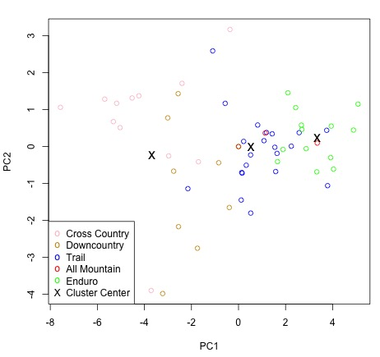
Cluster Centers on Principle Components
Visualizing cluster centers on 2 principle components.
‘All Mountain’ category completely overlapped between ‘Trail’ and ‘Enduro’.
Bottom two points are Nine brand bikes, which recommended size Medium, thus resulting in lower Reach measurements, which from above we see is a large factor in PC2.

Slide 21
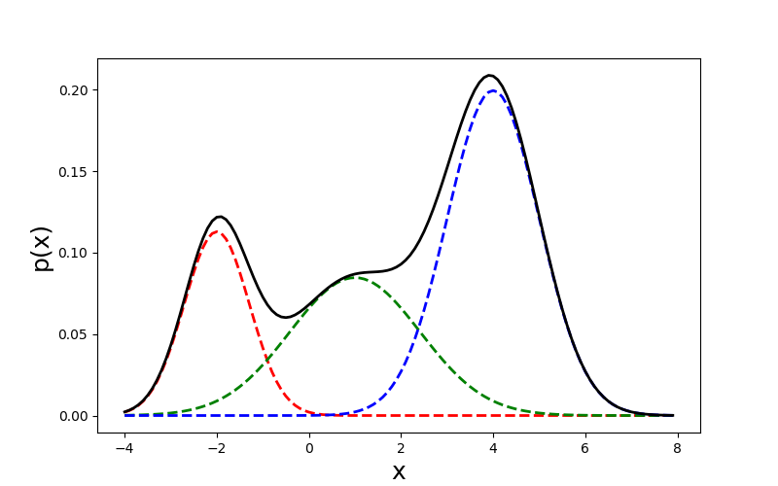
Gaussian Mixture Models (GMM)
In this section, we’ll take a more probabilistic model to our clustering. That is, we’ll use a Guassian Mixture Model (GMM) to build out normally distributed subgroupings within our mountain bike dataset, where the densities of each of the subgroupings represents a probability that a bike belongs to that subgrouping. Unlike K-Means, which is a more centroid-based clustering method, GMM is more of a distribution-based clustering method.
Theoretical GMM of MTB Categories
Enduro
XC
All-Mountain

Slide 22
Gaussian Mixture Models (GMM)
In this section, we’ll take a more probabilistic model to our clustering. That is, we’ll use a Guassian Mixture Model (GMM) to build out normally distributed subgroupings within our mountain bike dataset, where the densities of each of the subgroupings represents a probability that a bike belongs to that subgrouping. Unlike K-Means, which is a more centroid-based clustering method, GMM is more of a distribution-based clustering method.
Findings:
After running a few different flavors of GMM in R, we were unable to find more than one distinct cluster for the data, lending support to our hypothesis that the differentials between mountain bikes is more on a spectrum than grouped into specific categories.

Slide 23
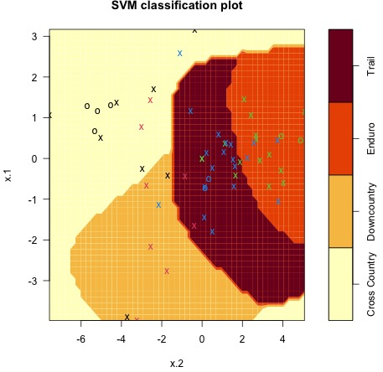
Supervised Learning
If we treat each bike label as truth, then we can model this as a supervised learning problem.
‘All Mountain’ Category combined with ‘Enduro’ due to similarities in initial PCA plot.

Slide 24
Supervised Learning
Support Vector Machine
60% accuracy when treating down country as separate category
77% accuracy when treating down country as XC
65% accuracy when treating downcountry as trail
Suggests that downcountry bikes are more akin to XC than they are trail

Slide 25

Findings/Conclusions

Slide 26
Findings
All results suggest that trying to discretely categorize full suspension mountain bikes is more or less arbitrary.
The categorization of a mountain bike should be treated as a continuous scale, with Cross Country bikes on one end and Enduro bikes on another.
To obtain where a specific bike lies on this scale, one can use the linear combination of the bike’s specifications and the first principle component.

Slide 27




Opportunities for Improved Analysis
There are a few opportunities to improve the analysis included in this presentation and forthcoming report:
Inclusion of more bikes (rows) | More rows = more robust clustering algorithms.
Inclusion of more bike features (columns) | Although we included the most meaningful specs/geometry of the bikes analyzed, there are dozens of other, smaller features that can be used to help differentiate between different types of bikes.
Include all sizes of bikes | We chose to use the size that corresponded to a 5’10” rider, but some bike manufacturers could interpret this as a Medium and others a Large.

